Slide 1
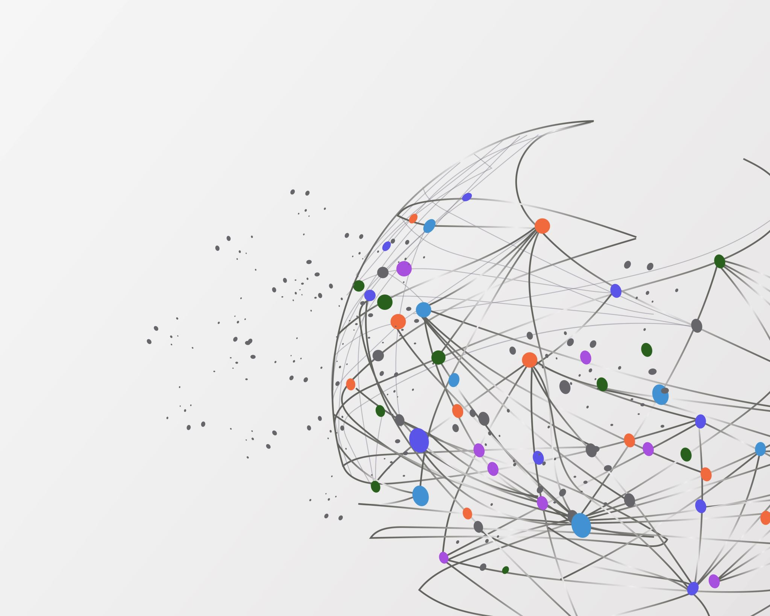
CPSC 591 Project Feature Lines + Attribute Based Mapping
Yuzhe Yi

Slide 2
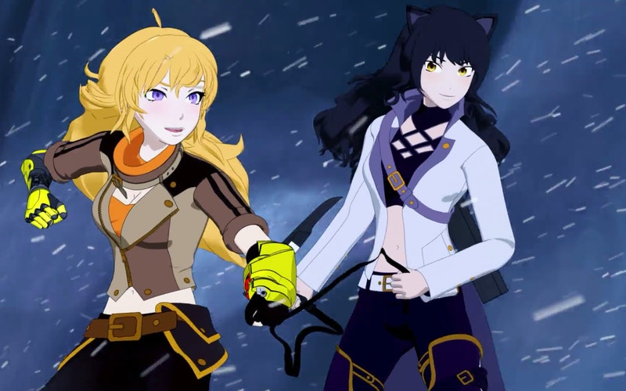
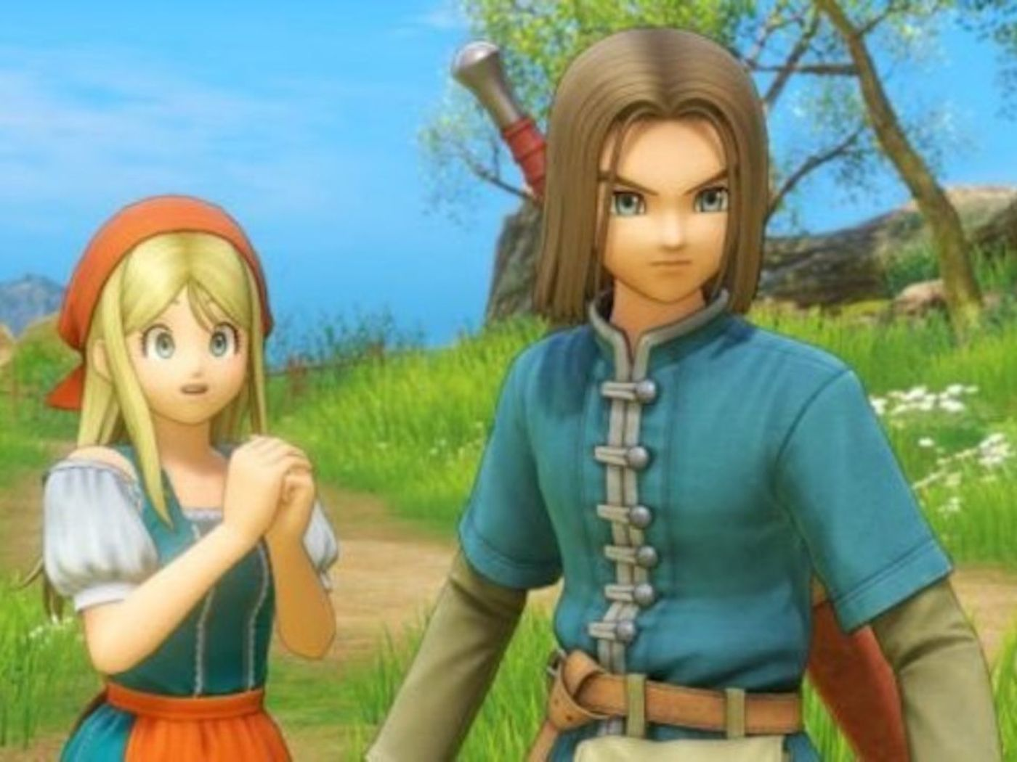
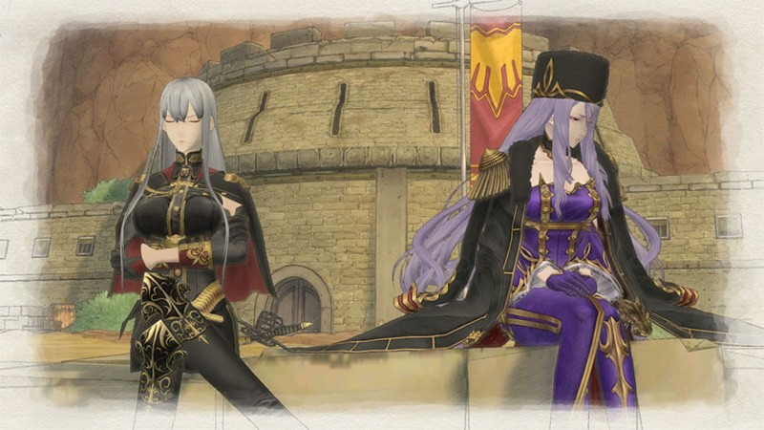
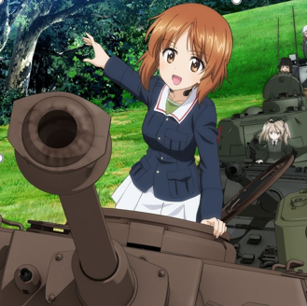
Motivation & Goal

Slide 3

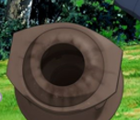
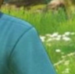
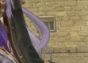






Motivation & Goal
Silhouette & crease
Silhouette & crease

Slide 4
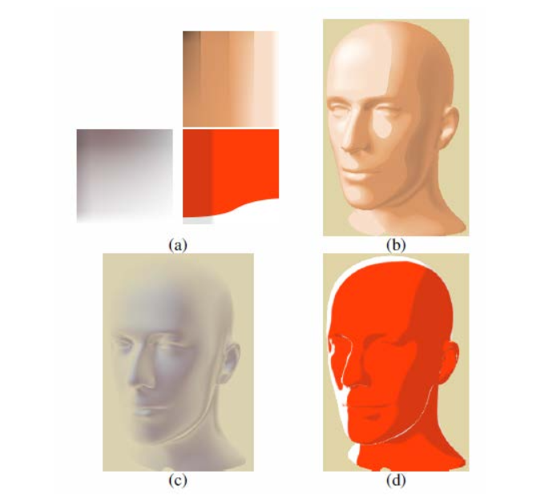
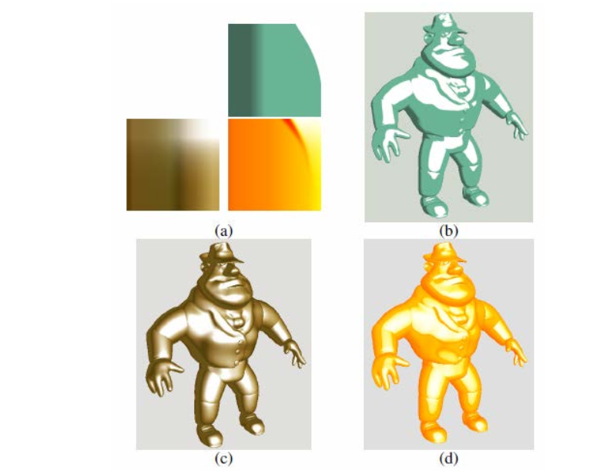
Motivation & Goal
From lecture, we learned attribute-based mapping.
However, we need to generate different textures for different color.

Slide 5
Motivation & Goal
From lecture, we learned attribute-based mapping.
Goal: user can select input color
However, we need to generate different textures for different color.

Slide 6
Feature Lines
Silhouette
Crease

Slide 7
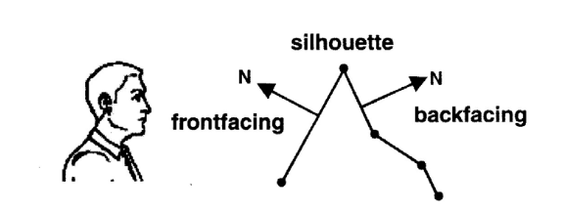
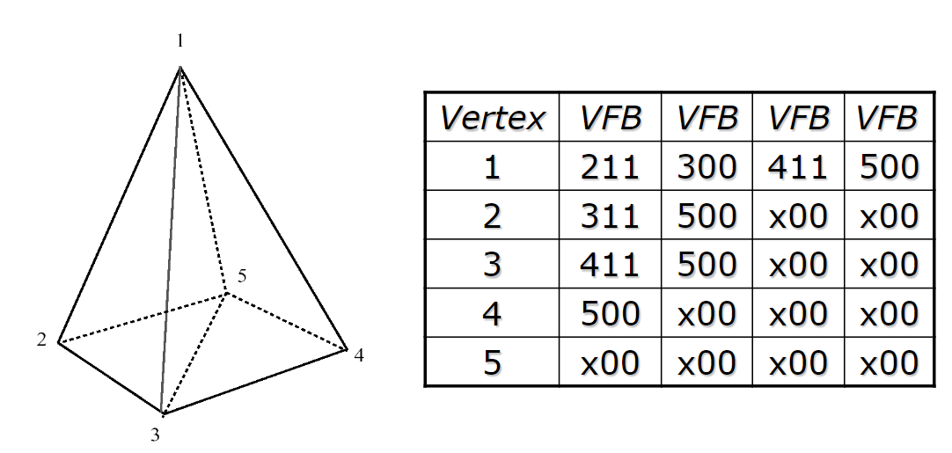
Silhouette
Algorithm from the lecture, using edge buffer

Slide 8
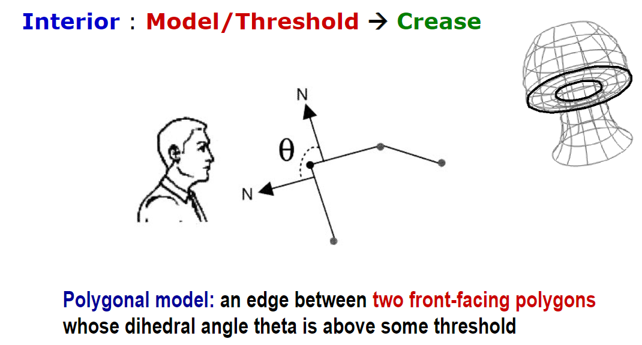
Crease
Also using edge buffer

Slide 9
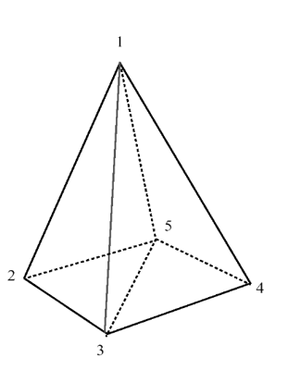
Crease
New edge buffer
Vertex | VFB Ns | VFB Ns | VFB Ns | VFB Ns
1 | 211 n1 n2 | 300 n1 n3 | … | …
2 | … | … | … | …
3 | … | … | … | …
4 | … | … | … | …
5 | … | … | … | …
n1 (x1, y1, z1)
n3 (x3, y3, z3)
n2 (x2, y2, z2)
1 edge is shared by 2 faces,
so it has 2 normal for each face

Slide 10
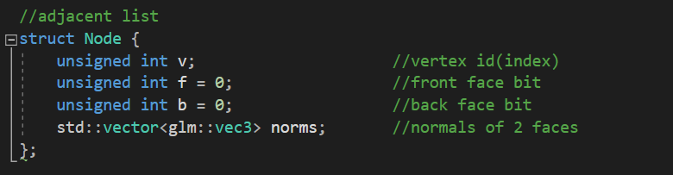
Crease
New edge buffer
Vertex | VFB Ns | VFB Ns | VFB Ns | VFB Ns
1 | 211 n1 n2 | 300 n1 n3 | … | …
2 | … | … | … | …
3 | … | … | … | …
4 | … | … | … | …
5 | … | … | … | …
n1 (x1, y1, z1)
n3 (x3, y3, z3)
n2 (x2, y2, z2)
Data structure
1 edge is shared by 2 faces,
so it has 2 normals

Slide 11
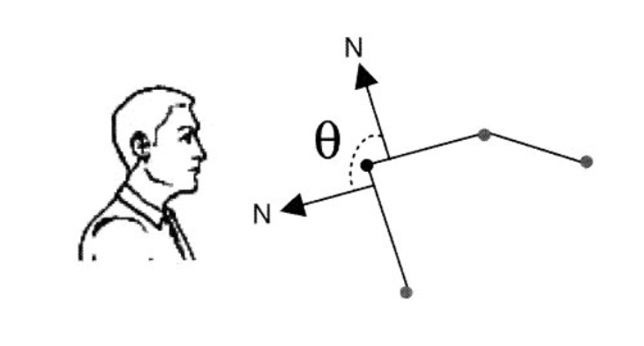
Crease
1
If theta >= threshold
render crease
180 – theta <= 180 – threshold
Dot(N1, N2) <= cos(180 - threshold)
180 - θ
2

Slide 12
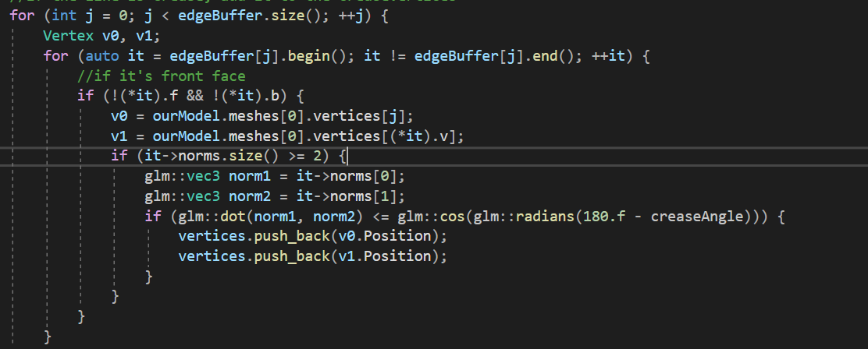
Crease
Only need to check front faces
If theta >= threshold
render crease
180 – theta <= 180 – threshold
Dot(N1, N2) <= cos(180 - threshold)
1
180 - θ
2
code

Slide 13
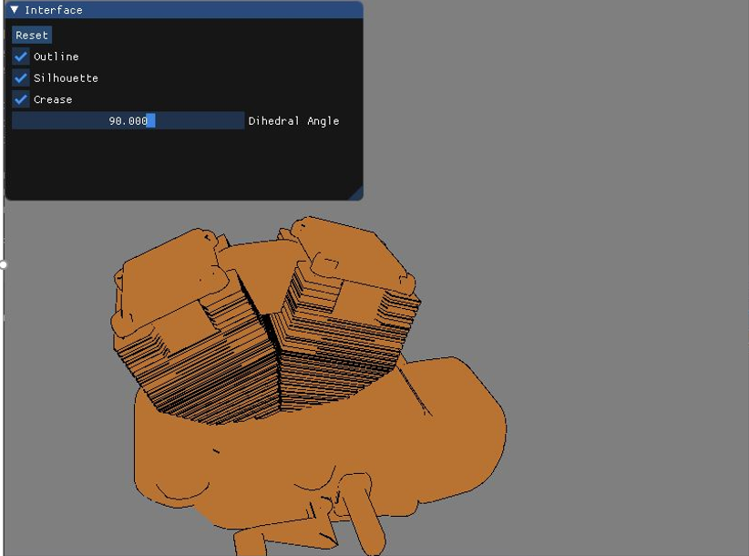
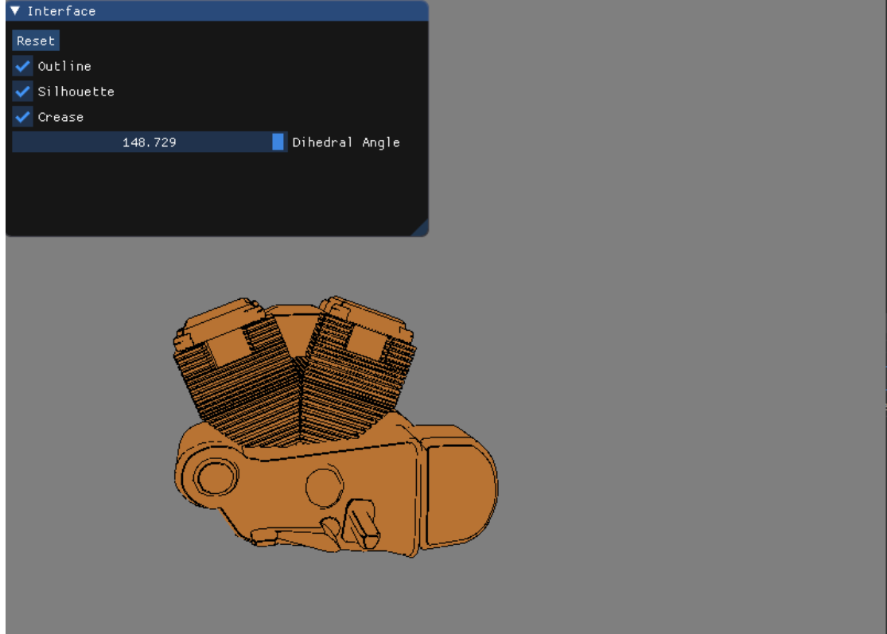
Result

Slide 14
Texture

Slide 15
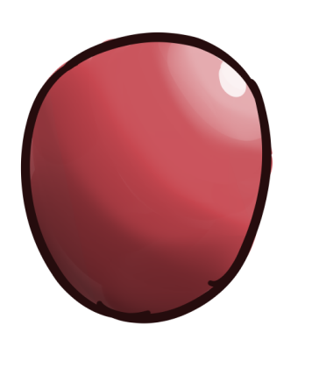
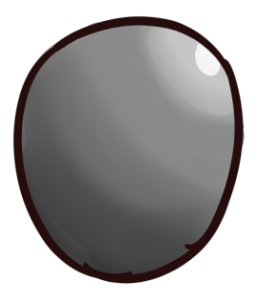
Related work
grayscale
color
Use black + white + gray to represent shadow & highlight
Color the object

Slide 16
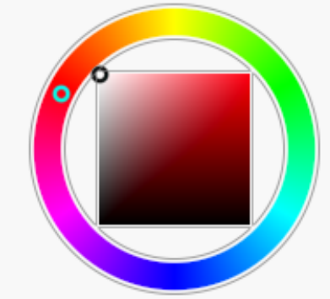

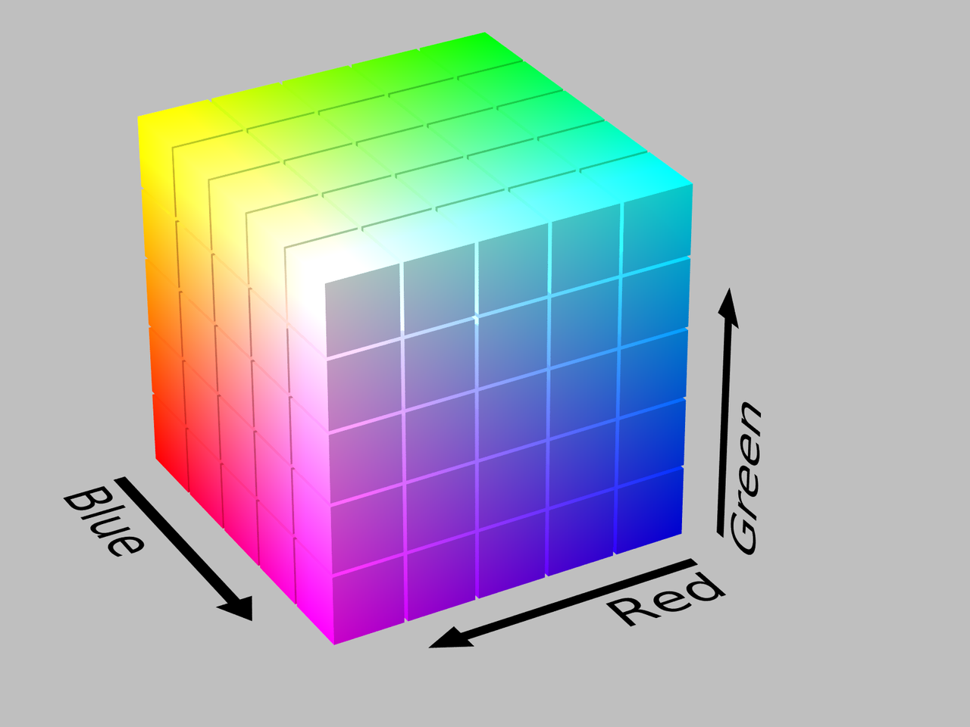

Hue
The "attribute of a visual sensation according to which an area appears to be similar to one of the perceived colors: red, yellow, green, and blue, or to a combination of two of them".
Saturation
The "colorfulness of a stimulus relative to its own brightness".
Value
The mixture of those paints with varying amounts of black or white paint
Hue
Saturation
Value

Slide 17
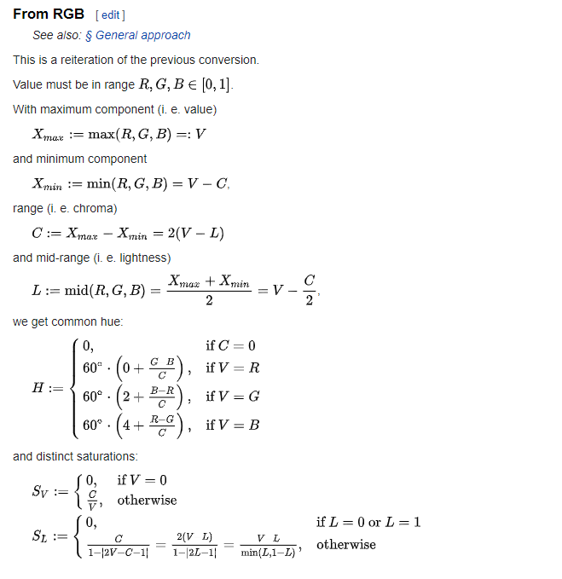
Conversion between RGB and HSV

Slide 18
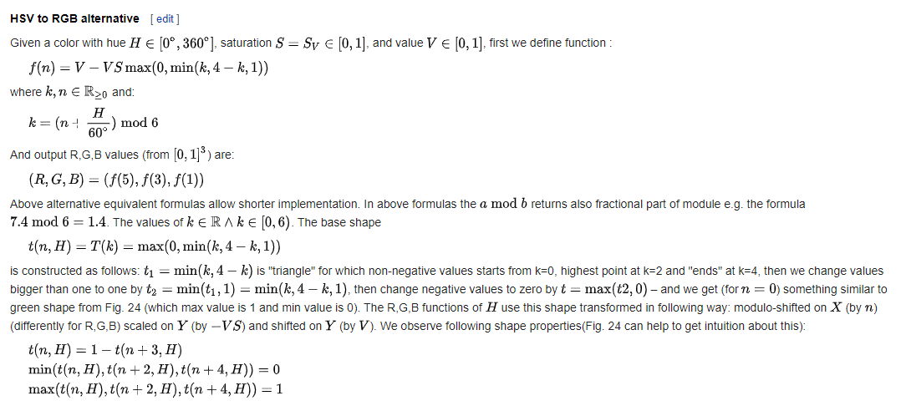
Conversion between RGB and HSV

Slide 19
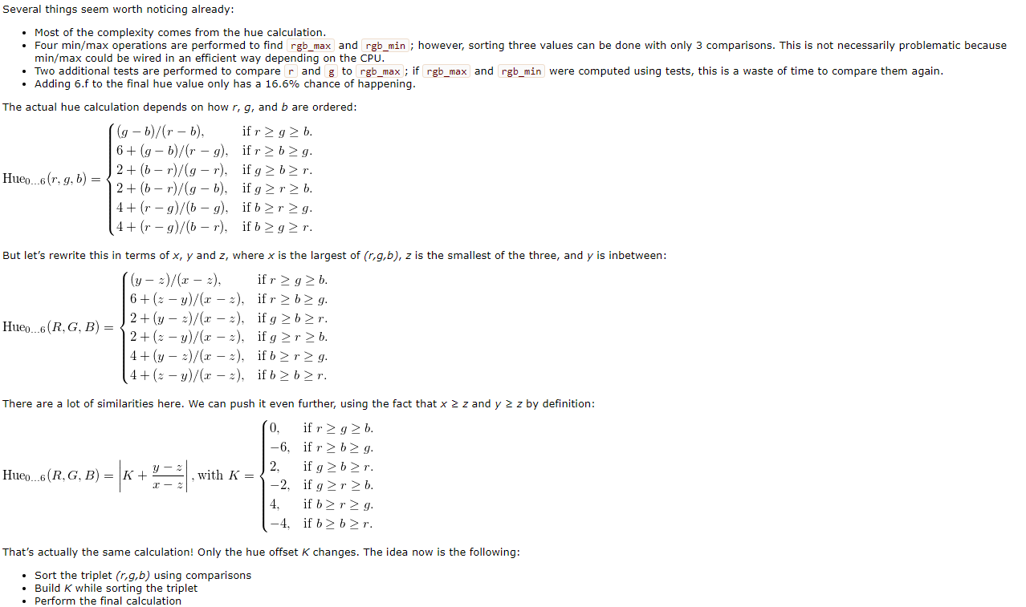
http://lolengine.net/blog/2013/01/13/fast-rgb-to-hsv

Slide 20
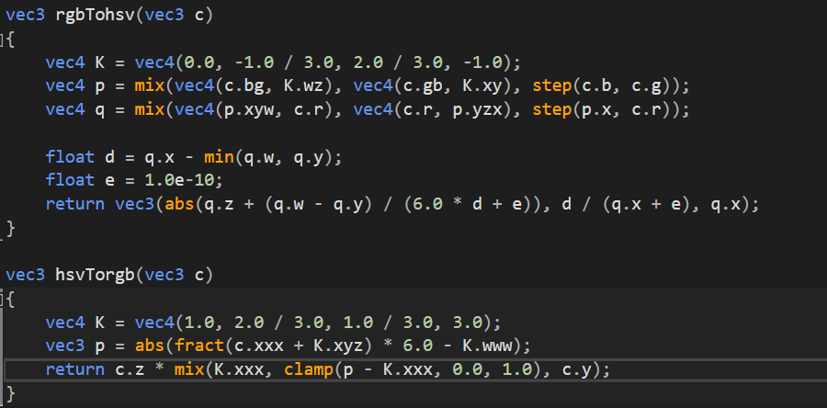
http://lolengine.net/blog/2013/07/27/rgb-to-hsv-in-glsl

Slide 21
From what we have learnt in NPR Tone-based Illumination + Shading, object colors change in sunlight scenes because cool skylight and warm sunlight vary in relative contribution across the surface.

Slide 22
From what we have learnt in NPR Tone-based Illumination + Shading, object colors change in sunlight scenes because cool skylight and warm sunlight vary in relative contribution across the surface.
Hue changes

Slide 23




From what we have learnt in NPR Tone-based Illumination + Shading, in real world, object colors change in sunlight scenes because cool skylight and warm sunlight vary in relative contribution across the surface.
Hue changes
highlight
highlight
shadow
shadow

Slide 24

Near-silhouette
+ color

Slide 25




highlight
90
0
360
highlight
shadow
shadow
270

Slide 26
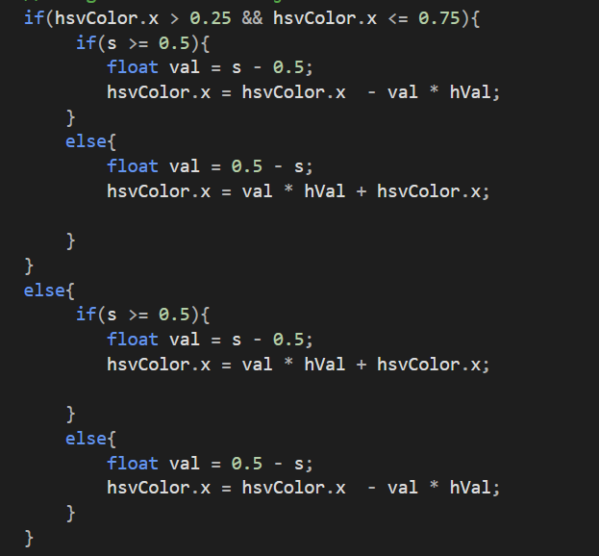




highlight
90
0
360
highlight
shadow
shadow
270

Slide 27

Highlight
white + other color = other color

Slide 28

Highlight
white + other color = other color

Slide 29
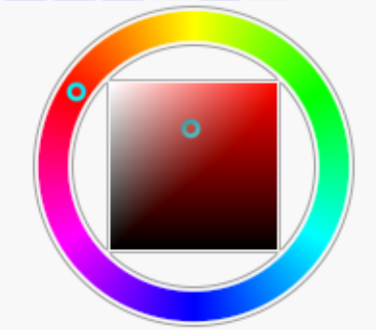
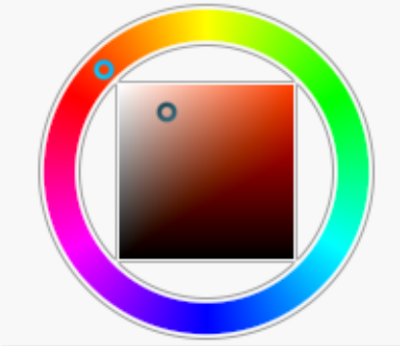

Highlight
white + other color = other color
1
2
Change H value
Decrease S value
Increase V value
3

Slide 30
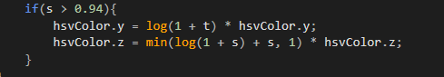

Highlight
white + other color = other color

Slide 31
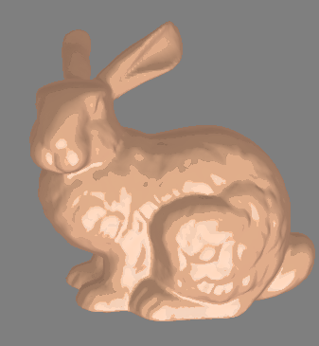
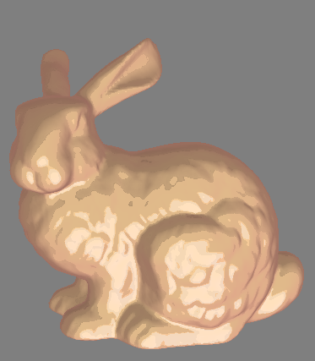
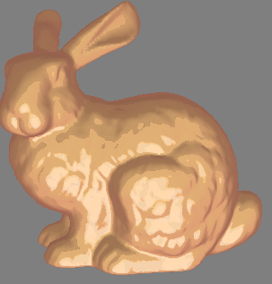
Final color
Original
Changed hVal
Changed opacity(how much to
blend the texture and color)
FragColour = vec4(texColour.xyz * objColor * opacity + texColour.xyz * (1 - opacity), 1.0);

Slide 32
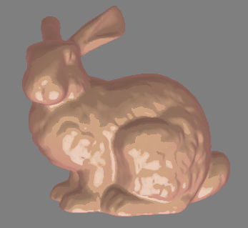
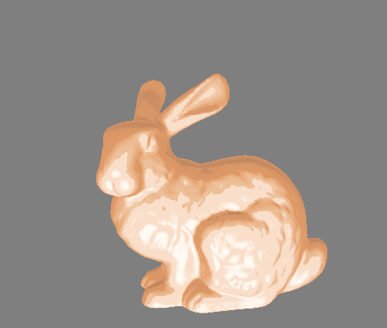
Compared with assignment 3
project
assignment

Slide 33

Metal
+ color

Slide 34

Hue is the same as near-silhouette texture
But metal has shiny highlight
Blend
white + other color = other color

Slide 35
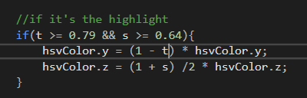

Hue is the same as non-metal texture
But metal has shiny highlight

Slide 36
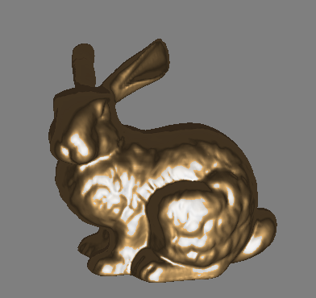
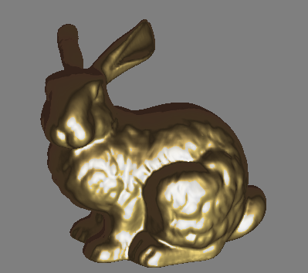
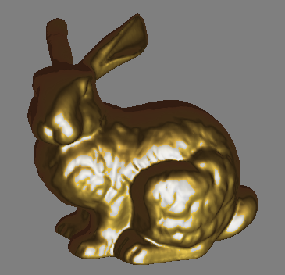
Final color
Original
Changed hVal
Changed opacity(how much to
blend the texture and color)
FragColour = vec4(texColour.xyz * objColor * opacity + texColour.xyz * (1 - opacity), 1.0);

Slide 37
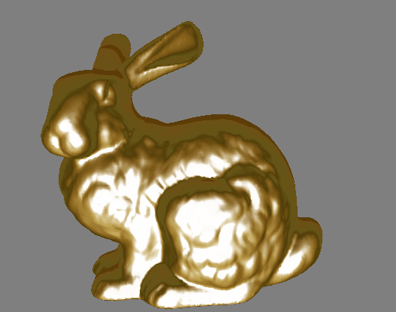
Compared with assignment 3
project
assignment

Slide 38
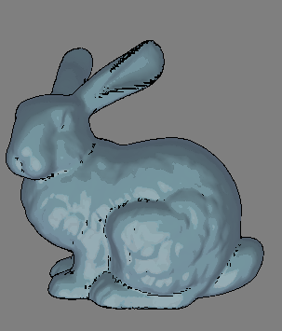
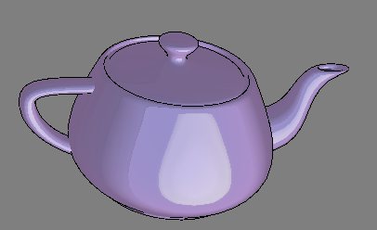
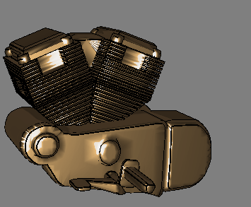
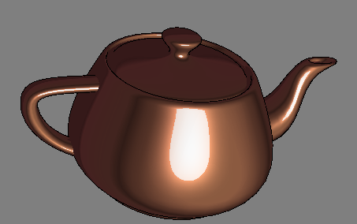
Result

Slide 39
Limitations & future directions
Explore more textures
Improve feature lines
Use function model to generate textures

Slide 40
Reference
Gooch-et-al-1998
Buchanan-Costa_Sousa-2000
Barla-et-al-2006
Maureen C. Stone (August 2001). "A Survey of Color for Computer Graphics". Course at SIGGRAPH 2001.
MacEvoy, Bruce. "handprint : colormaking attributes". www.handprint.com. Retrieved 26 February 2019.
https://en.wikipedia.org/wiki/HSL_and_HSV#Formal_derivation
http://lolengine.net/blog/2013/01/13/fast-rgb-to-hsv
http://lolengine.net/blog/2013/07/27/rgb-to-hsv-in-glsl

